Slide 1

IRONHACK
Hunting your next prey:
Your new job

Slide 2

Our purpose
📊 Understanding of the job hunting process & key tasks.
🦹🏽 Gaining more control over the process & achieve your desired outcome.

Slide 3


INDEX
♻️ The job-hunt stages
💻 Project management tips
🌀 The Circle of Influence
Notes:
In this session we will give you a generic overview of the entire cycle of the job searching process (the different stages, etc.)
You will also have a chance to understand the typical sentence of “looking for a job is actually a full time job”
But that’s okay because we will introduce you to the idea of taking over the job hunt as your new project (aside from the ones you’ll be involved in to improve your portfolio and acquire technical experience!)
We will touch on again a key aspect for you to be successful: understanding your remits of true control so that you spend less time worrying about things that do not depend on you and work towards improving the ones you have full control over
We will also share some tips on how to organise your time and manage your job hunting project
Really good job portals & communities
And finish up with some general tips on how to navigate the process by interacting with the different stakeholders involved in your hiring processes.

Slide 4
From the wild to the
workforce
Hunting in the jungle & the job-hunt

Slide 5

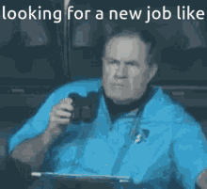
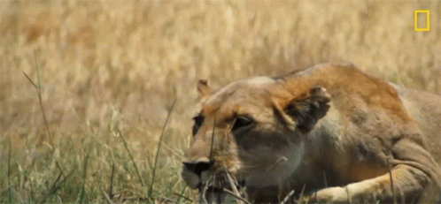
Here goes A title
🧐
Notes:
It’s funny that in English we use the word “hunt” to describe the job searching process.
But if you stop to think about it - it’s surely not a coincidence.
Can you already think of what common things could the job search have with, for instance, a leopard hunting a prey in the wild?

Slide 6
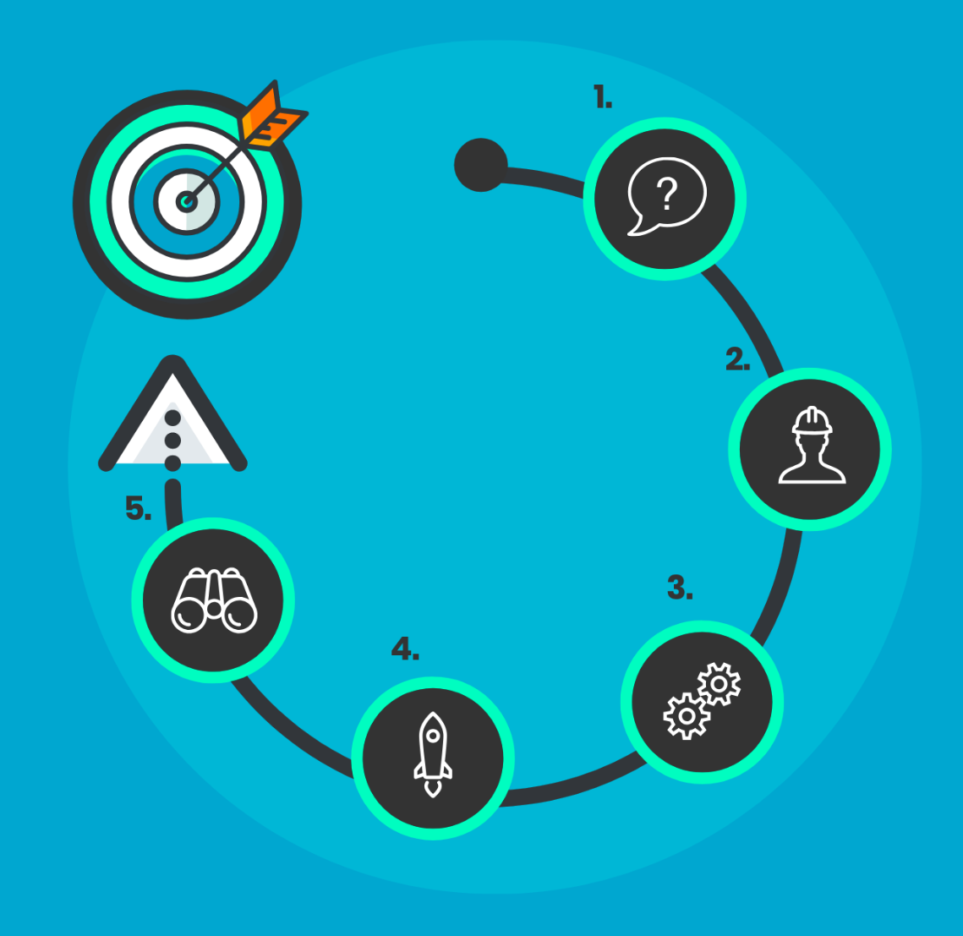
Job seeking and hunting:
a total match!
Both are PROCESSES.
Notes:
Both are complex processes
We need to know what exactly it is we’re after - we need a specific goal, a prey :)
It requires planning - as you’ll soon find out, we need to research everything around our goal (the roles, the market, the companies, the procedures, etc.)
This means we will ideally have to have a strategy if we want to be effective and stand out among the competition
But don’t forget that attitude is EVERYTHING in any endeavour in life, because whenever the road gets bumpy, our ability to keep a calm and positive mindset is what will actually help us overcome the difficulties
Patience
Creativity is also a key attribute you’ll have to develop if you really want to stand out from the crowd - take our recommendations seriously, but what else can you bring to the table? Think out of the box
And then lastly, it requires you to be skilled at what you’re after.

Slide 7

Job seeking and hunting:
a total match!
Both are PROCESSES.
They require a prey, A GOAL.
Notes:
Both are complex processes
We need to know what exactly it is we’re after - we need a specific goal, a prey :)
It requires planning - as you’ll soon find out, we need to research everything around our goal (the roles, the market, the companies, the procedures, etc.)
This means we will ideally have to have a strategy if we want to be effective and stand out among the competition
But don’t forget that attitude is EVERYTHING in any endeavour in life, because whenever the road gets bumpy, our ability to keep a calm and positive mindset is what will actually help us overcome the difficulties
Patience
Creativity is also a key attribute you’ll have to develop if you really want to stand out from the crowd - take our recommendations seriously, but what else can you bring to the table? Think out of the box
And then lastly, it requires you to be skilled at what you’re after.

Slide 8

Job seeking and hunting:
a total match!
Both are PROCESSES.
They require a prey, A GOAL.
They take THOROUGH PREPARATION, PLANNING and STRATEGY building.
Notes:
Both are complex processes
We need to know what exactly it is we’re after - we need a specific goal, a prey :)
It requires planning - as you’ll soon find out, we need to research everything around our goal (the roles, the market, the companies, the procedures, etc.)
This means we will ideally have to have a strategy if we want to be effective and stand out among the competition
But don’t forget that attitude is EVERYTHING in any endeavour in life, because whenever the road gets bumpy, our ability to keep a calm and positive mindset is what will actually help us overcome the difficulties
Patience
Creativity is also a key attribute you’ll have to develop if you really want to stand out from the crowd - take our recommendations seriously, but what else can you bring to the table? Think out of the box
And then lastly, it requires you to be skilled at what you’re after.

Slide 9

Job seeking and hunting:
a total match!
Both are PROCESSES.
They require a prey, A GOAL.
They take THOROUGH PREPARATION, PLANNING and STRATEGY building.
They demand ATTITUDE
Notes:
Both are complex processes
We need to know what exactly it is we’re after - we need a specific goal, a prey :)
It requires planning - as you’ll soon find out, we need to research everything around our goal (the roles, the market, the companies, the procedures, etc.)
This means we will ideally have to have a strategy if we want to be effective and stand out among the competition
But don’t forget that attitude is EVERYTHING in any endeavour in life, because whenever the road gets bumpy, our ability to keep a calm and positive mindset is what will actually help us overcome the difficulties
Patience
Creativity is also a key attribute you’ll have to develop if you really want to stand out from the crowd - take our recommendations seriously, but what else can you bring to the table? Think out of the box
And then lastly, it requires you to be skilled at what you’re after.

Slide 10

Job seeking and hunting:
a total match!
Both are PROCESSES.
They require a prey, A GOAL.
They take THOROUGH PREPARATION, PLANNING and STRATEGY building.
They demand ATTITUDE
And require PATIENCE, CREATIVITY and the right SKILLS.
Notes:
Both are complex processes
We need to know what exactly it is we’re after - we need a specific goal, a prey :)
It requires planning - as you’ll soon find out, we need to research everything around our goal (the roles, the market, the companies, the procedures, etc.)
This means we will ideally have to have a strategy if we want to be effective and stand out among the competition
But don’t forget that attitude is EVERYTHING in any endeavour in life, because whenever the road gets bumpy, our ability to keep a calm and positive mindset is what will actually help us overcome the difficulties
Patience
Creativity is also a key attribute you’ll have to develop if you really want to stand out from the crowd - take our recommendations seriously, but what else can you bring to the table? Think out of the box
And then lastly, it requires you to be skilled at what you’re after.

Slide 11
The job hunting process:
The cycle and its different stages

Slide 12
The stages of the process
EXPLORING
PREPARING
APPLYING
INTERVIEWS
OFFER
NEGOTIATE
CLOSING
Notes:
As mentioned earlier, the job hunt is a process that consists of differentiated stages. Let’s look into those to better understand what is required from us at each one. Havimg a general understanding of these stages gives you a framework, a guide and a sense of direction
There is an initial stage :
The first part is the part where we have to do our homework (what are my strengths, skills, what do I want, where is the info, how do I apply, etc.)
It’s where we have to look for the jobs itself - explore, research the market and start applying to what we think fits our needs and profile.
It’s also when we pass the initial application filter that we have to prepare for the interview.
The second stage starts from the moment we have the first interview phone call.
Depending on the company, you may have an initial call, then a first HR interview to analyse your general fit for the role, then a tech challenge, maybe a third one with the CEO/CTO, etc.
And then if successful, the very last stages of the interview will be about specifying the details of the job (offer, contract, negotiation, etc.) which we will cover in the next few days in a bit more in depth

Slide 13
Early Stages of the hiring process
EXPLORING
PREPARING
APPLYING
EXPLORATION
PREPARATION
Self-reflection
Understanding of own goals and vision.
Understanding of the market and its needs.
Understand personal skills and improvement areas.
Research the company of interest.
Understand needs, goals and challenges.
Assessing your experience & specific skills required.
Research the company’s network.
Adapt CV & CL.
Work with IH Coach.
Apply and connect with influencers & decision makers.
Prepare HR interview.
Notes:
As mentioned earlier, the job hunt is a process that consists of differentiated stages. Let’s look into those to better understand what is required from us at each one. Havimg a general understanding of these stages gives you a framework, a guide and a sense of direction
There is an initial stage :
The first part is the part where we have to do our homework (what are my strengths, skills, what do I want, where is the info, how do I apply, etc.)
It’s where we have to look for the jobs itself - explore, research the market and start applying to what we think fits our needs and profile.
It’s also when we pass the initial application filter that we have to prepare for the interview.
The second stage starts from the moment we have the first interview phone call.
Depending on the company, you may have an initial call, then a first HR interview to analyse your general fit for the role, then a tech challenge, maybe a third one with the CEO/CTO, etc.
And then if successful, the very last stages of the interview will be about specifying the details of the job (offer, contract, negotiation, etc.) which we will cover in the next few days in a bit more in depth

Slide 14
Early Stages of the hiring process
EXPLORING
PREPARING
APPLYING
EXPLORATION
PREPARATION
Self-reflection
Understanding of own goals and vision.
Understanding of the market and its needs.
Understand personal skills and improvement areas.
Research the company of interest.
Understand needs, goals and challenges.
Assessing your experience & specific skills required.
Research the company’s network.
Adapt CV & CL.
Work with IH Coach.
Apply and connect with influencers & decision makers.
Prepare HR interview.
Notes:
As mentioned earlier, the job hunt is a process that consists of differentiated stages. Let’s look into those to better understand what is required from us at each one. Havimg a general understanding of these stages gives you a framework, a guide and a sense of direction
There is an initial stage :
The first part is the part where we have to do our homework (what are my strengths, skills, what do I want, where is the info, how do I apply, etc.)
It’s where we have to look for the jobs itself - explore, research the market and start applying to what we think fits our needs and profile.
It’s also when we pass the initial application filter that we have to prepare for the interview.
The second stage starts from the moment we have the first interview phone call.
Depending on the company, you may have an initial call, then a first HR interview to analyse your general fit for the role, then a tech challenge, maybe a third one with the CEO/CTO, etc.
And then if successful, the very last stages of the interview will be about specifying the details of the job (offer, contract, negotiation, etc.) which we will cover in the next few days in a bit more in depth

Slide 15
Early Stages of the hiring process
EXPLORING
PREPARING
APPLYING
EXPLORATION
PREPARATION
Self-reflection
Understanding of own goals and vision.
Understanding of the market and its needs.
Understand personal skills and improvement areas.
Research the company of interest.
Understand needs, goals and challenges.
Assessing your experience & specific skills required.
Research the company’s network.
Adapt CV & CL.
Work with IH Coach.
Apply and connect with influencers & decision makers.
Prepare HR interview.
Notes:
As mentioned earlier, the job hunt is a process that consists of differentiated stages. Let’s look into those to better understand what is required from us at each one. Havimg a general understanding of these stages gives you a framework, a guide and a sense of direction
There is an initial stage :
The first part is the part where we have to do our homework (what are my strengths, skills, what do I want, where is the info, how do I apply, etc.)
It’s where we have to look for the jobs itself - explore, research the market and start applying to what we think fits our needs and profile.
It’s also when we pass the initial application filter that we have to prepare for the interview.
The second stage starts from the moment we have the first interview phone call.
Depending on the company, you may have an initial call, then a first HR interview to analyse your general fit for the role, then a tech challenge, maybe a third one with the CEO/CTO, etc.
And then if successful, the very last stages of the interview will be about specifying the details of the job (offer, contract, negotiation, etc.) which we will cover in the next few days in a bit more in depth

Slide 16
Advanced stages of the hiring process
INTERVIEWS
NEGOTIATE
Balance nerves & confidence.
Communication skills.
Ability to read the room.
Answer the questions
Be ready for not
knowing all answers.
Ability to leverage experience and value.
Prepare relevant questions for interviewer(s).
Consider the offer.
Evaluate benefits.
Understand value in the market.
Communication skills.
Negotiation.
Accept or reject.
INTERVIEWS
OFFER
NEGOTIATE
CLOSING
Notes:
But as you can see each stage requires a different focus, set of tasks or skills
The initial stage of exploration requires a both inside and outside exploration - of our own and the market landscape. This “prework stage” will actually contribute to the quality of our application and performance in the process
Once we spot an opportunity, there’s a bunch of aspects to research on so that our application is well adapted and catches the attention of the recruiter
During the interview phases - you will have to master a set of skills ranging from balancing your nerves, being able to read the room, to showcasing your communication skills and market knowledge. This comes with a lot of practice!
Once we receive a job offer we should feel proud of ourselves of course! But it’s important not to forget than even at this stage the job isn’t done yet. A work contract is a deal/agreement - so it’s in your best interest to take your time to consider all pros and cons and negotiate what’s best for you.

Slide 17
Advanced stages of the hiring process
INTERVIEWS
NEGOTIATE
Balance nerves & confidence.
Communication skills.
Ability to read the room.
Answer the questions
Be ready for not
knowing all answers.
Ability to leverage experience and value.
Prepare relevant questions for interviewer(s).
Consider the offer.
Evaluate benefits.
Understand value in the market.
Communication skills.
Negotiation.
Accept or reject.
INTERVIEWS
OFFER
NEGOTIATE
CLOSING
Notes:
But as you can see each stage requires a different focus, set of tasks or skills
The initial stage of exploration requires a both inside and outside exploration - of our own and the market landscape. This “prework stage” will actually contribute to the quality of our application and performance in the process
Once we spot an opportunity, there’s a bunch of aspects to research on so that our application is well adapted and catches the attention of the recruiter
During the interview phases - you will have to master a set of skills ranging from balancing your nerves, being able to read the room, to showcasing your communication skills and market knowledge. This comes with a lot of practice!
Once we receive a job offer we should feel proud of ourselves of course! But it’s important not to forget than even at this stage the job isn’t done yet. A work contract is a deal/agreement - so it’s in your best interest to take your time to consider all pros and cons and negotiate what’s best for you.

Slide 18
Advanced stages of the hiring process
INTERVIEWS
NEGOTIATE
Balance nerves & confidence.
Communication skills.
Ability to read the room.
Answer the questions
Be ready for not.
Knowing all answers.
Ability to leverage experience and value.
Prepare relevant questions for interviewer(s).
Consider the offer.
Evaluate benefits.
Understand value in the market.
Communication skills.
Negotiation.
Accept or reject.
INTERVIEWS
OFFER
NEGOTIATE
CLOSING
Notes:
But as you can see each stage requires a different focus, set of tasks or skills
The initial stage of exploration requires a both inside and outside exploration - of our own and the market landscape. This “prework stage” will actually contribute to the quality of our application and performance in the process
Once we spot an opportunity, there’s a bunch of aspects to research on so that our application is well adapted and catches the attention of the recruiter
During the interview phases - you will have to master a set of skills ranging from balancing your nerves, being able to read the room, to showcasing your communication skills and market knowledge. This comes with a lot of practice!
Once we receive a job offer we should feel proud of ourselves of course! But it’s important not to forget than even at this stage the job isn’t done yet. A work contract is a deal/agreement - so it’s in your best interest to take your time to consider all pros and cons and negotiate what’s best for you.

Slide 19
How to manage the job hunt
as a project…
And like a pro!

Slide 20

Key actions
DEFINE YOUR VISION
Long and mid-term goals
(SMART)
Phase
01

Slide 21
Key actions
DEFINE YOUR VISION
Long and mid-term goals
(SMART)
Phase
Phase
01
02
ACTION PLAN
Identify short term goals (weekly, bi-weekly, monthly).

Slide 22
Key actions
DEFINE YOUR VISION
Long and mid-term goals
(SMART)
🎯 Set weekly goals
What do you want to achieve?
What needs to be done?
What is your deadline?
Phase
Phase
01
02
ACTION PLAN
Identify short term goals (weekly, bi-weekly, monthly).

Slide 23
Key actions
DEFINE YOUR VISION
OBSTACLES AND NEEDS
Long and mid-term goals
(SMART)
What would you do in case you find an obstacle?
Phase
Phase
Phase
01
02
03
ACTION PLAN
Identify short term goals (weekly, bi-weekly, monthly).

Slide 24
Key actions
DEFINE YOUR VISION
OBSTACLES AND NEEDS
Long and mid-term goals
(SMART)
What would you do in case you find an obstacle?
✔ WOOP method
Phase
Phase
Phase
Wish
Outcome
Obstacle
Plan
01
02
03
ACTION PLAN
Identify short term goals (weekly, bi-weekly, monthly).

Slide 25
Key actions
DEFINE YOUR VISION
OBSTACLES AND NEEDS
Long and mid-term goals
(SMART)
What would you do in case you find an obstacle?
Phase
Phase
Phase
Phase
01
02
03
04
ACTION PLAN
TRACK
Identify short term goals (weekly, bi-weekly, monthly).
Are you following the plan?
Is it working?

Slide 26
Key actions
DEFINE YOUR VISION
OBSTACLES AND NEEDS
Long and mid-term goals
(SMART)
What would you do in case you find an obstacle?
💻 Use Agile tools
Phase
Be organised!
Trello boards, Notion, Excel, Huntr…
Phase
Phase
Phase
01
02
03
04
ACTION PLAN
TRACK
Identify short term goals (weekly, bi-weekly, monthly).
Are you following the plan?
Is it working?

Slide 27
Key actions
DEFINE YOUR VISION
OBSTACLES AND NEEDS
ITERATE
Long and mid-term goals
(SMART)
What would you do in case you find an obstacle?
Keep what’s working, change what’s not.
Phase
Phase
Phase
Phase
Phase
01
02
03
04
05
ACTION PLAN
TRACK
Identify short term goals (weekly, bi-weekly, monthly).
Are you following the plan?
Is it working?

Slide 28
Key actions
DEFINE YOUR VISION
OBSTACLES AND NEEDS
ITERATE
Long and mid-term goals
(SMART)
What would you do in case you find an obstacle?
Keep what’s working, change what’s not.
📊 Track your evolution
Phase
Phase
Phase
Phase
Phase
01
02
03
04
05
Are you achieving your goals?
What’s working? What’s not? What new things will you do next?
ACTION PLAN
TRACK
Identify short term goals (weekly, bi-weekly, monthly).
Are you following the plan?
Is it working?

Slide 29
Key actions
DEFINE YOUR VISION
OBSTACLES AND NEEDS
ITERATE
Long and mid-term goals
(SMART)
What would you do in case you find an obstacle?
Keep what’s working, change what’s not.
Phase
Phase
Phase
Phase
Phase
01
02
03
04
05
ACTION PLAN
TRACK
Identify short term goals (weekly, bi-weekly, monthly).
Are you following the plan?
Is it working?

Slide 30
🎯 Set weekly goals
💻 Use Agile tools
What do you want to achieve?
What needs to be done?
What is your deadline?
Be organised!
Trello boards, Notion, Excel, Huntr…
What do you want to achieve?
What needs to be done?
What is your deadline?
✔ WOOP method
📊 Track your evolution
Wish
Outcome
Obstacle
Plan
Are you achieving your goals?
What’s working? What’s not? What new things will you do next?

Slide 31
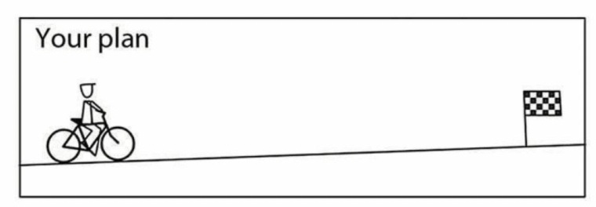
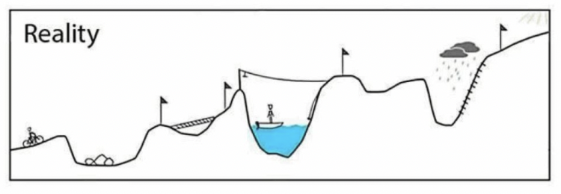
Expectations
versus Reality

Slide 32
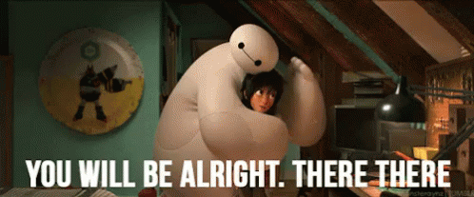
Let’s focus our energy on
what we can control /influence 🎉 instead of what we can’t 😣

Slide 33
The Circle of Influence
Where and how you can influence the process

Slide 34

CONCERN
It doesn’t depend on us We can’t do anything
INFLUENCE
CIRCLE OF CONTROL
It doesn’t depend 100% on us but we can do something to influence it
It depends 100% on us!

Slide 35
Let’s reflect on this
Make a list of different factors that make you feel worried about your upcoming job search.
Classify those things according to the circle of influence:
What are totally out of your control? (External circle: concerns).
What are under your control and you can change? (inner circle: area of control).
What are things you can influence in some way? (mid circle: circle of influence).

Slide 36
Other candidates
Discrimination (nationality, gender, age, etc.)
Jobs are for seniors
Market saturation
Economy
A company’s decision
Not receiving a reply
Not getting feedback
The content of the bootcamp.
CONCERN

Slide 37
Can’t control the job market, but can tailor our applications and build connections.
Can’t control companies’ culture, but you can find ways to relate to their values and mission/decide if you want to be part of it or not.
Can’t control the HR decision on hiring you, but can show enthusiasm and the value of your skills.
INFLUENCE

Slide 38
Gaining confidence through practice
Being committed
Your attitude/thoughts
Organise your time
Setting weekly goals
Having a strategy
Tracking progress
Honing skills
Take in feedback to progress
Be open to new things
Willingness to improve
Working on building a network
Learning from others
i.e. Ironhacker Alumni
CIRCLE OF CONTROL

Slide 39
How to expand your
Circle of Influence

Slide 40

Ask yourself questions before making statements.
What can I do differently? What can I try that I haven’t yet?
Who could help me with other perspective?
Reorganize your actions accordingly.

Slide 41
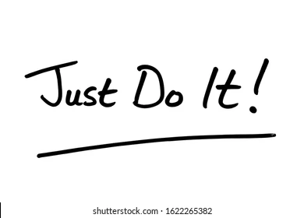
TAKE ACTION: Keep in mind: there are things you can’t control, but you may INFLUENCE them:
Online and onsite networking.
Research companies you want to be part of, and tailor your applications to fit their needs.
Volunteer or intern.
Keep building your skills: create projects or improve the ones you already have.
Be proactive: apply, look for people that work in those companies, ask for feedback, do spontaneous applications.
Look for a mentor.
Use social media!

Slide 42

Look for opportunities for having conversations with:
Other colleagues.
Mentors.
People with more experience.
Invite people for coffee or lunch!!!!

Slide 43
Networking to expand your circle of influence.

Slide 44
Why networking?
Access to hidden job opportunities
2. Establish yourself in the industry
Build your brand, learn what people talk about, know what's going on and share your perspective.
3. Professional development & building relationships
Community (belonging), learning, having a good time, not feeling alone, sharing with others.

Slide 45
How can I start networking?
Start posting, at least once per week.
Comment on companies’ and other people’s posts, and repost them.
Connect with relevant people from your industry:
Find common topics.
Ask them a question.
I saw your post about…
I saw your question on this post…
Join communities to identify topics and relevant people from your field.
Attend online and onsite events.

Slide 46
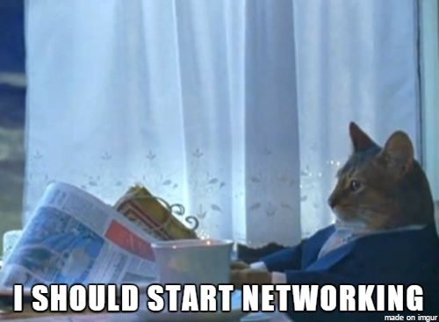
Use social media for your benefit:
Share your knowledge.
Talk about what’s important to you.
Get relevant professionals to know you.

Slide 47

How to start posting?
Find your topic (bootcamp topic).
Look for individuals/companies that talk about it & get some inspiration.
Share comments: personal experiences, reflections, questions…
Share their posts with your own opinions and insights: “I tried this and it worked!”
FIND INSPIRATION BY READING OTHER PEOPLE’S POSTS!

Slide 48
Connection messages examples
For a recruiter:
Hello ____, I see that you’re the recruiter in charge of the ____ position at ____. I am very interested in applying but would like to ask you a few questions first. Let’s connect.
For a tech industry expert:
Hello ____, I saw that you also liked ____’s post on ____. I am a big fan of his/her work. His/her advice worked well for me! Anyways, I would love to connect and maybe even discuss it further.
For an Ironhacker:
Hello ____, I see that we are both in the _____industry and would love to have you in my network and we both did the _____ bootcamp at Ironhack. Let’s connect!

Slide 49
Connection messages examples
For a recruiter:
Hello ____, I see that you’re the recruiter in charge of the ____ position at ____. I am very interested in applying but would like to ask you a few questions first. Let’s connect.
For a tech industry expert:
Hello ____, I saw that you also liked ____’s post on ____. I am a big fan of his/her work. His/her advice worked well for me! Anyways, I would love to connect and maybe even discuss it further.
For an Ironhacker:
Hello ____, I see that we are both in the _____industry and would love to have you in my network and we both did the _____ bootcamp at Ironhack. Let’s connect!

Slide 50
Connection messages examples
For a recruiter:
Hello ____, I see that you’re the recruiter in charge of the ____ position at ____. I am very interested in applying but would like to ask you a few questions first. Let’s connect.
For a tech industry expert:
Hello ____, I saw that you also liked ____’s post on ____. I am a big fan of his/her work. His/her advice worked well for me! Anyways, I would love to connect and maybe even discuss it further.
For an Ironhacker:
Hello ____, I see that we are both in the _____industry and would love to have you in my network and we both did the _____ bootcamp at Ironhack. Let’s connect!

Slide 51
Connection messages examples
For a recruiter:
Hello ____, I see that you’re the recruiter in charge of the ____ position at ____. I am very interested in applying but would like to ask you a few questions first. Let’s connect.
For a tech industry expert:
Hello ____, I saw that you also liked ____’s post on ____. I am a big fan of his/her work. His/her advice worked well for me! Anyways, I would love to connect and maybe even discuss it further.
For an Ironhacker:
Hello ____, I see that we are both in the _____industry and would love to have you in my network and we both did the _____ bootcamp at Ironhack. Let’s connect!

Slide 52

Networking Toolkit
Connection messages.
More templates and ideas.
Networking challenge.
The art of LinkedIn - workshop.
Look for online and onsite events.

Slide 53


